Slide 1
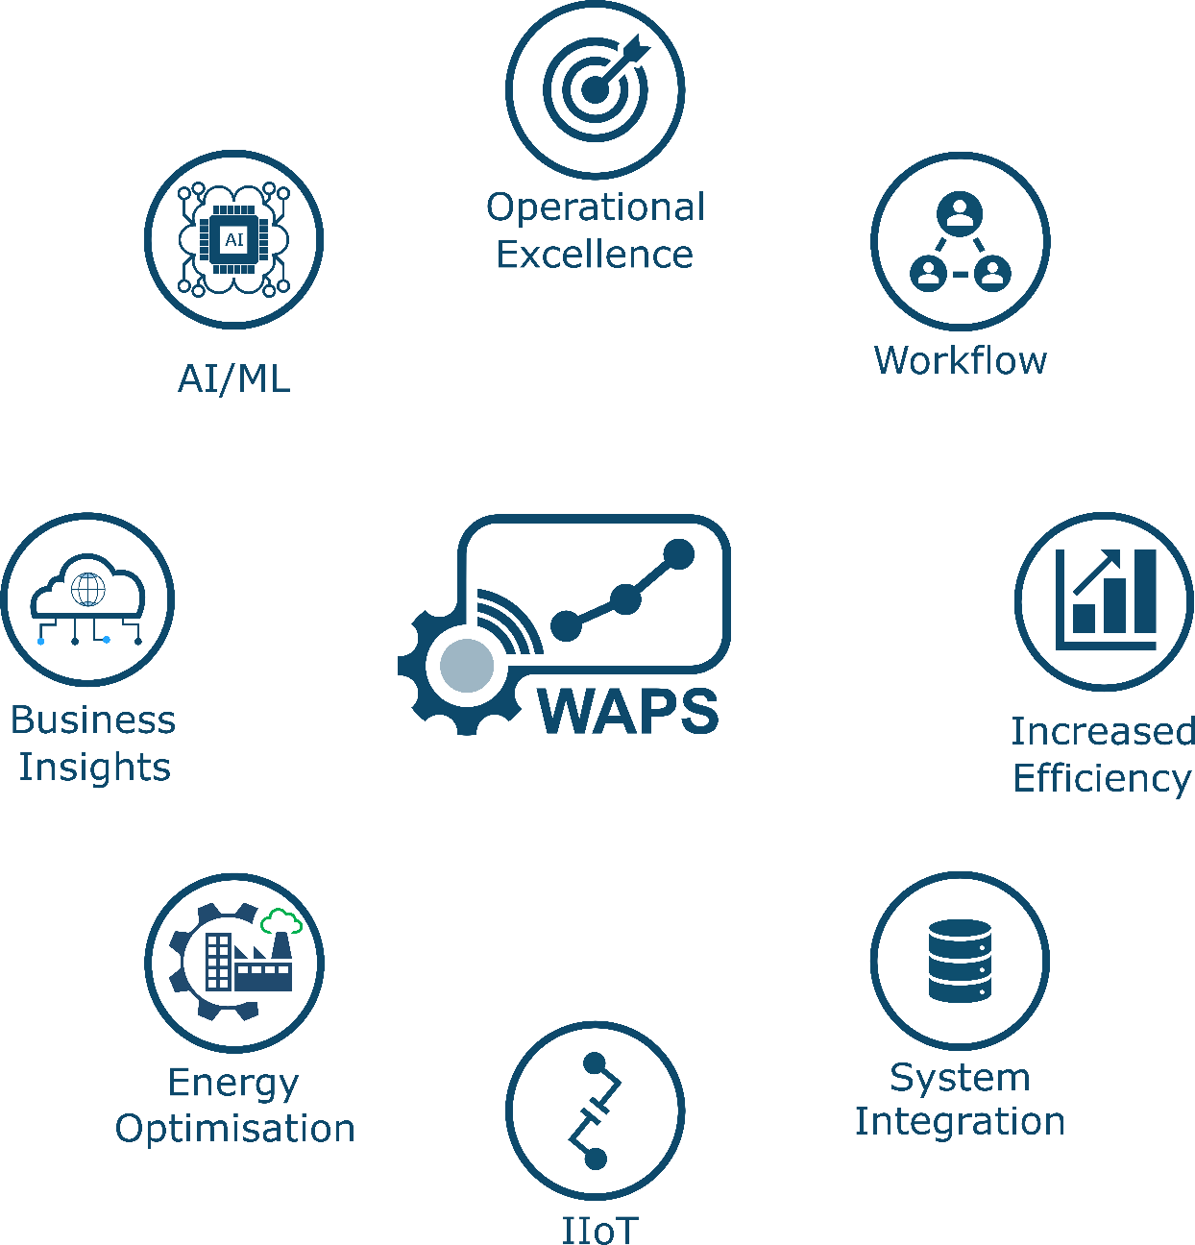
IIOT Hardware FOR Data acquisition
Solution Overview

Slide 2

SmartFactory IIoT Connectivity Solutions
Making Real-Time Data Acquisition Smart, Fast, Ultra-Reliable and Affordable
SmartFactory’s IIoT solutions have been designed to tackle one of the biggest challenges in manufacturing: collection of process, equipment, and environmental data from manual processes or legacy equipment. Our standard connectivity solutions integrate rugged industrial hardware, from the leaders in industrial automation.
Performance and Condition Monitoring
Wireless data capture for Downtime, Scrap, Rework, Vibration, Temperature, and Current, etc.
Sustainability and SEU Monitoring
Wired and Wireless data Capture for Energy and Utilities usage (Electricity, Gas, Water, Compressed Air, etc.).
Identification & Locating Solutions
Including Vision systems, barcode readers, RFID, and Real Time Locating Systems (RTLS).
Smart Connectivity Solutions
Industrial-grade cybersecurity and network infrastructure, plug and play integrations.
Workflows & Process Automation
Pick-to-Light, Call-for-Parts and Call-for-Help.

Slide 3
Performance Monitoring Solutions
Track. Analyse. Improve.
SmartFactory’s Performance Monitoring solutions are designed to provide complete visibility into your production operations — manual or automated. Designed for fast deployment and long-term reliability, these solutions are trusted by global manufacturers to reduce downtime, optimise productivity, and support Continuous Improvement initiatives.
The standard solutions include:
IIoT Toolkit #1: Out-of-the-Box IIoT Platform
A turnkey data collection and visualisation platform, preloaded with Kepware, Historian, WAPS (real-time dashboards), SQL, Power BI Gateway and more.
IIoT Toolkit #2: Wired/Wireless Gateways and Cleanroom Expansion Kit
Extend sensor coverage wirelessly in cleanrooms and isolated production areas using these wired and wireless gateways.
IIoT Toolkit #3: Flexible Wireless I/O Nodes
Highly adaptable wireless nodes with multiple I/O configurations — suitable for capturing signals from sensors, switches, counters, thermistors, and more.
IIoT Toolkit #4: Wireless Condition Monitoring Node
Monitor machine health in real-time with vibration, temperature, and current sensors. Perfect for proactive maintenance.
IIoT Toolkit #5: Wireless Output & State Monitoring
A complete, pre-configured solution to wirelessly collect real-time production output and workstation states. Cost-effective and ideal for any manual or semi-automated process.
Sensor Solutions for Manual Assembly
Capture cycle time, part placement, or manual actions with smart wired sensors connected directly to wireless nodes.
SensingCam: Visual Downtime Analysis
Revolutionise your root-cause analysis with visual confirmation of events. The SensingCam records up to 40 seconds before/after a trigger.

Slide 4
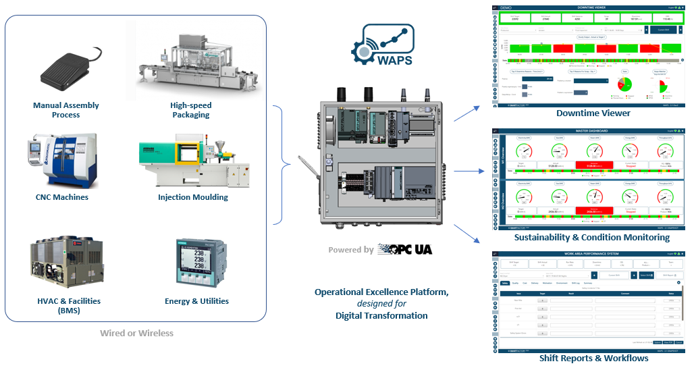
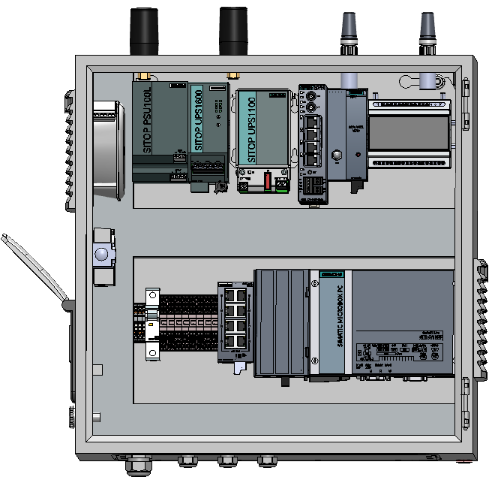
IIoT Toolkit (kit #1)
Out-of-the-box data collection, analytics and visualisation (Kepware, Historian, SQL, WAPS Dashboards and Power BI gateway)
Pre-configured with the following modules:
User Management (LDAP/SSO optional)
Product Manager (ERP integration optional)
Work Order Manager (MES integration optional)
Downtime Viewer (Day-by-Hour, Downtime, Scrap, Pareto, OEE, etc.)
Call-for-Help/Call-for-Parts
Sustainability & Condition Monitoring (Energy, Utilities, Vibration, etc.)
Workflow and Digital Daily Management System (Pick-to-Light, Shift Report, Production Summary Report, Label Reconciliation)
MAPS and Grid/Site View (Dynamic KPI dashboards/maps, RTLS and RFID)
SMA214 (with CE mark)
Siemens PSU/UPS with OPC UA
Siemens Firewall/NAT/VPN device (optional)
Siemens WiFi AP (optional)
Banner DXM700 wireless sensor gateway
Siemens omni-directional antenna
Siemens 8-port switch
Siemens IPC (Windows 10 inc. x2 VM’s)
Compact - Rittal enclosure (500x500x300)

Slide 5
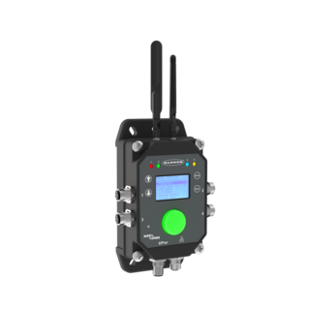
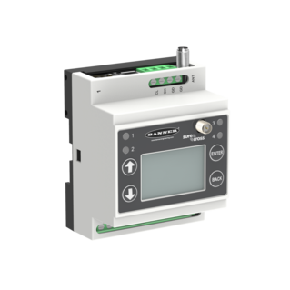
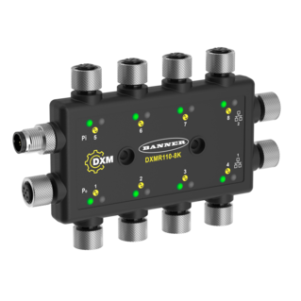
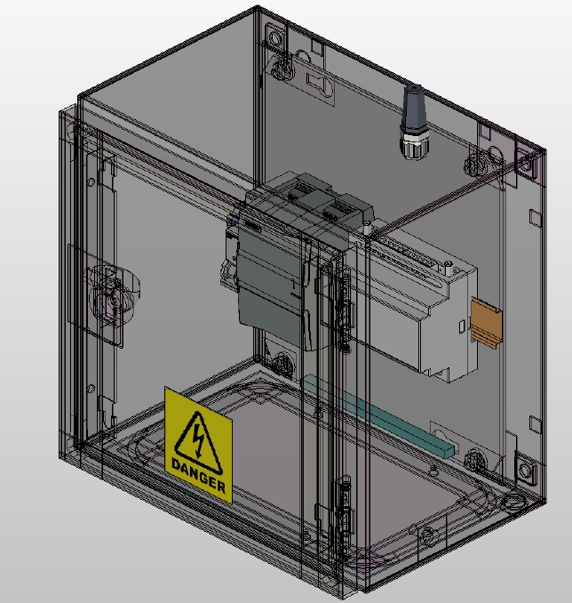
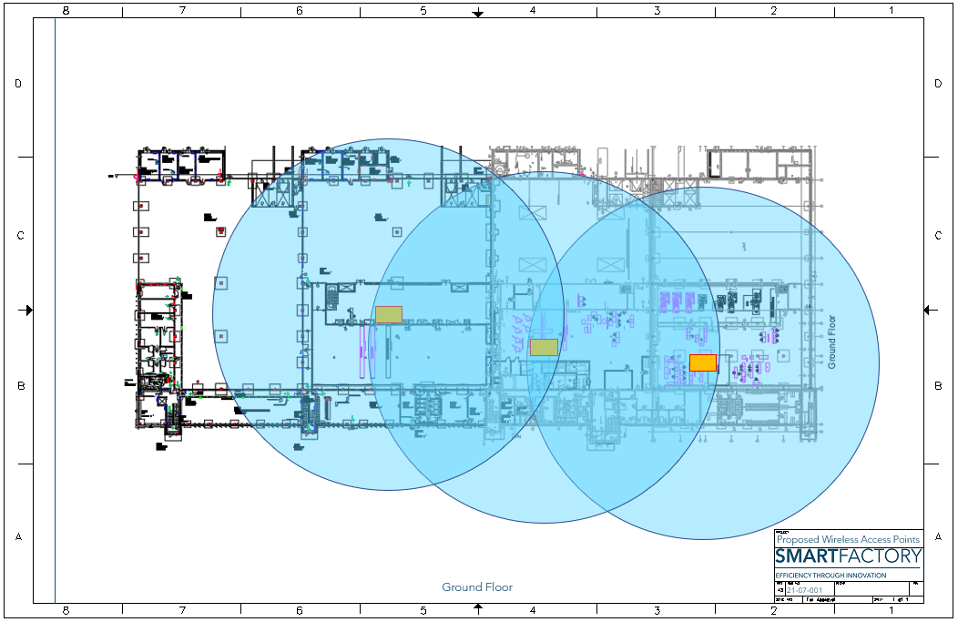
IIoT Toolkit (kit #2)
Wired and Wireless Gateways Simplified IIoT Integration with secure, easily scalable and robust gateways. They support various industrial protocols including IO Link, Modbus RTU, Modbus TCP, and EtherNet/IP, ensuring seamless integration with existing automation systems.
They use frequency hopping spread spectrum (FHSS) for reliable communication and rugged industrial housings, up to IP67-rated.
Extend Monitoring into Controlled Environments Quickly expand wireless sensor coverage into cleanrooms or isolated areas using this plug-and-play kit.
SMA230 (with CE mark)
Siemens PSU/UPS
Banner DXM700
Siemens omni-directional antenna
Rittal enclosure (300x300x210)
Multi Cleanroom Facility

Slide 6
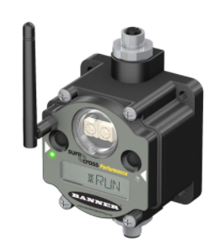
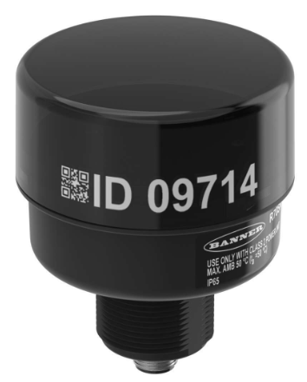
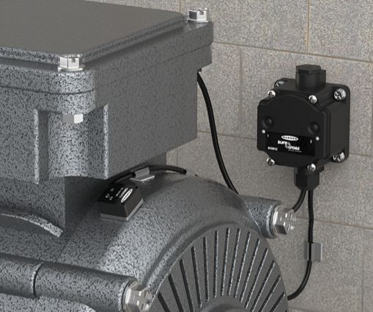
IIoT Toolkit (kit #3)
Connect Any Signal, From Any Sensor – Wirelessly
Modular nodes designed to support almost any I/O configuration: analogue, digital, thermistor, counters, or serial data — all over a secure wireless link.
Flex-power™ and battery powered options available
DX80 Nodes Configurable Inputs and Outputs (PNP/PNP), 0-10v and 0-20mA Analogue I/O and 1-wire Serial Interface.
Support multiple wireless network topologies including Point-to-Multipoint, Bus, Ring, Star, Tree and Mesh.
R70 Serial Radios Highly flexible, low-power wireless devices which can be configured as a Master, Repeater or Slave.
MultiHop technology, which enables them to form self-healing, auto-routing mesh networks. Rugged design and reliable performance in industrial environments.
IIoT Toolkit (kit #4)
Proactive Maintenance, Without the Complexity
Monitor vibration, current, and temperature data in real-time — all from a compact wireless node with pre-configured sensors.
DX80DR2M-H10
Pre-Configured for Vibration and Temperature Sensors and Current Transformer.
Battery powered options available.
Link to Condition Monitoring video

Slide 7


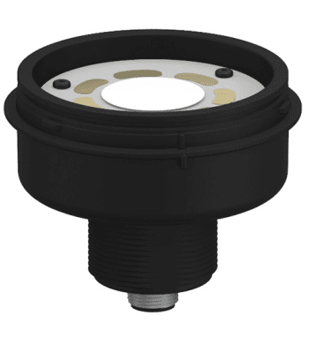

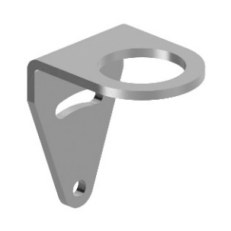
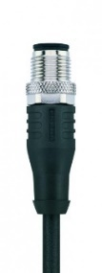
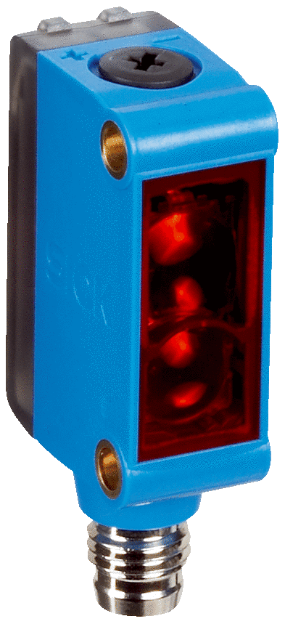
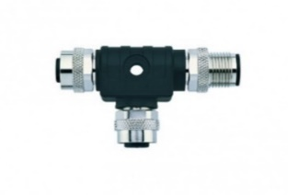
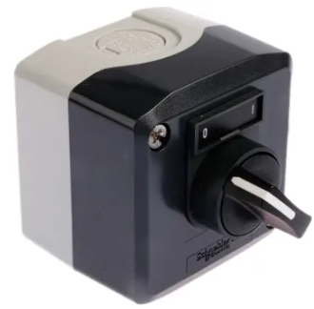
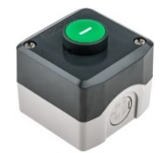
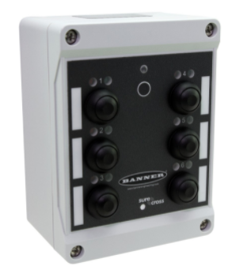
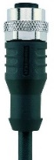
IIoT Toolkit (kit #5)
Highly flexible, scalable and quick to install
Complete solution to wirelessly capture real-time production output and state, from any manual workstation or automated production unit
LED Segment for
State or Call-for-Help programmable with 14 colours
Wireless Node for State with high speed counter
Stainless Steel bracket
Product/Cycle Counter (required)
Derived State (optional)
Call-for-Help button
Set-up Mode selector switch
Wireless Pendant for Scrap Count and Reasons
24v or Li-Ion powered
+
Single 8-pin M12 quick disconnect cable (required)
10-30v dc
-

Slide 8
IIoT Toolkit (kit #5)
Highly flexible, scalable and quick to install
Complete solution to wirelessly capture real-time production output and state, from any manual workstation or automated production unit
LED Segment for
State or Call-for-Help programmable with 14 colours
Wireless Node for State with high speed counter
Stainless Steel bracket
Product/Cycle Counter (required)
Derived State (optional)
Call-for-Help button
Set-up Mode selector switch
Wireless sensor for Scrap Count
+
Single 8-pin M12 quick disconnect cable (required)
10-30v dc
-

Slide 9
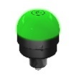
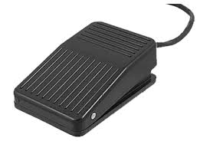
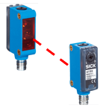
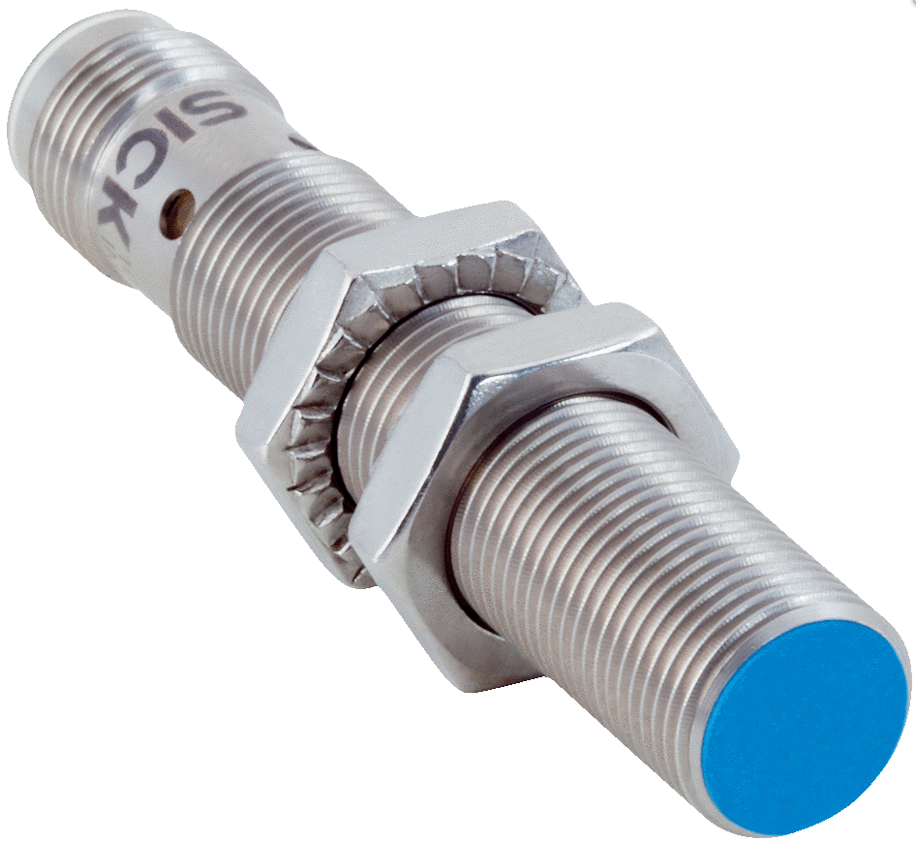
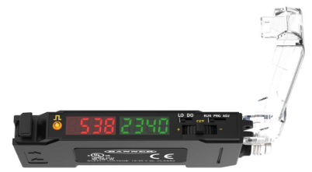

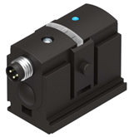
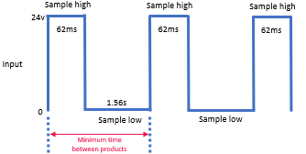



Sensor Solutions for Manual Assembly
Make Every Manual Task Measurable
Capture cycle time, operator actions, or part placement using smart wired sensors connected to wireless nodes.
Manual Activation
Touch button
Foot switch
Part Placement or Machine Cycle
Photo-optic sensor
Inductive sensor
Fibre-optic sensor
Machine Cycle
Pressure-switch
Current relay
To avoid double counts or missed counts on manual stations, the signal from the part-counting sensor, can be “conditioned” (anti-bounce, anti-miss)
Sample Rate is the scan time of all nodes in the network: 62.5ms (fastest possible)

Slide 10
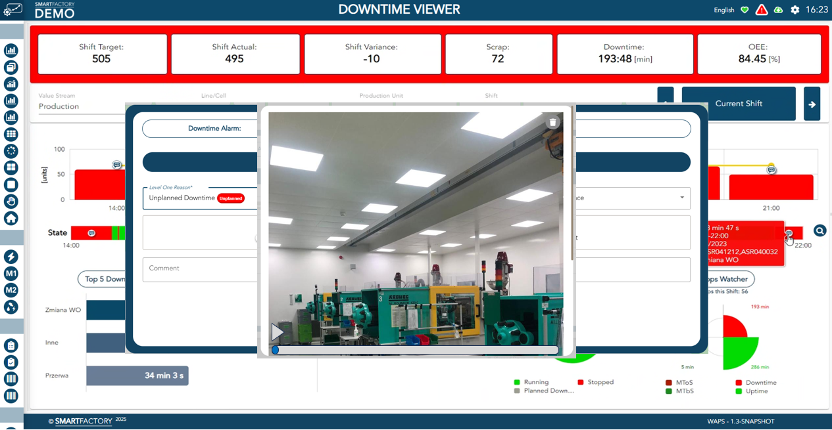
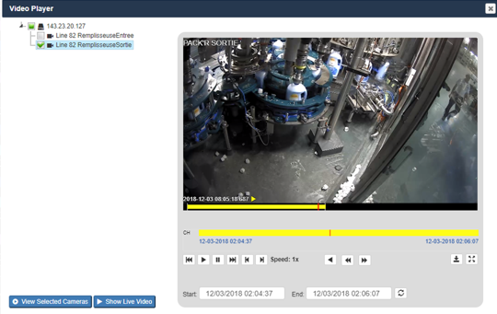
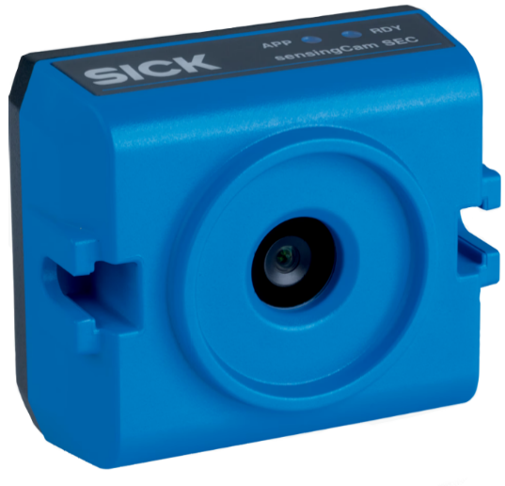
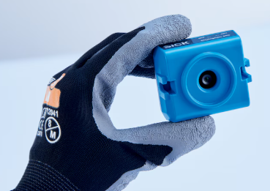
See the unseen
Revolutionise downtime analysis with visual root-cause insights
Event recording hardware
Event recording (up to 40s before/after trigger)
Full integration into Downtime Viewer Software
Can be triggered by wireless sensor
Streaming/Remote monitoring
Snapshot/Quality documentation
Industrial rugged design
Miniature size
RTSP or MJPEG stream
6GB storage
58mm
Link to sensingCam Video
Datasheet

Slide 11
Energy and Utility Monitoring
See Every Kilowatt. Track Every Drop.
SmartFactory’s energy monitoring solutions give you the ability to easily and precisely measure, log, and analyse energy usage across your facility enabling better decisions, faster diagnostics, and measurable sustainability improvements.
Monitor power consumption at the plant, line, or machine level. Choose from DIN-rail, panel-mount, or self-powered energy meters with Modbus integration.
A broad range of CTs lets you monitor current draw from almost any machine or panel, with minimal installation effort.
Liquid Insight Without the Hassle
Measure usage of water and other conductive liquids with pulse-based sensors that integrate easily and quickly with wireless sensors. The optional clamp-on meters can be easily retrofitted to existing pipework, without cutting pipes or production downtime.
Stop Guessing Your Air Consumption
Compressed air is expensive — this solution helps you detect overuse, leaks or inefficient systems by monitoring localised usage in real time. The optional clamp-on meters can be easily retrofitted to existing pipework, without cutting pipes or production downtime.

Slide 12
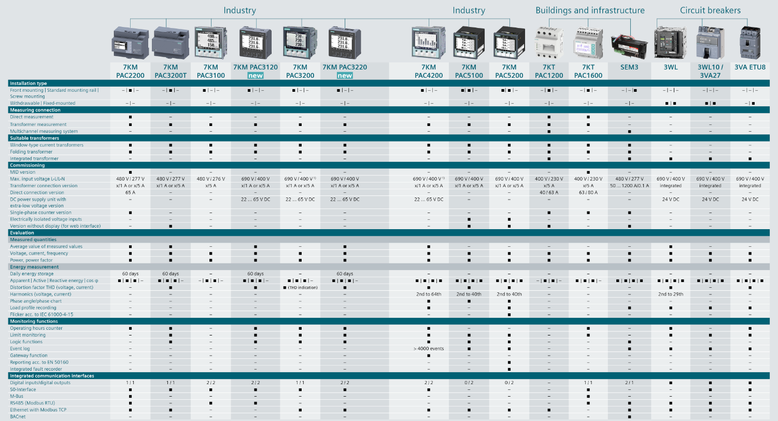
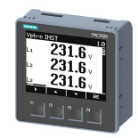
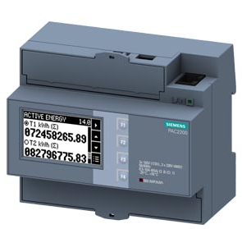
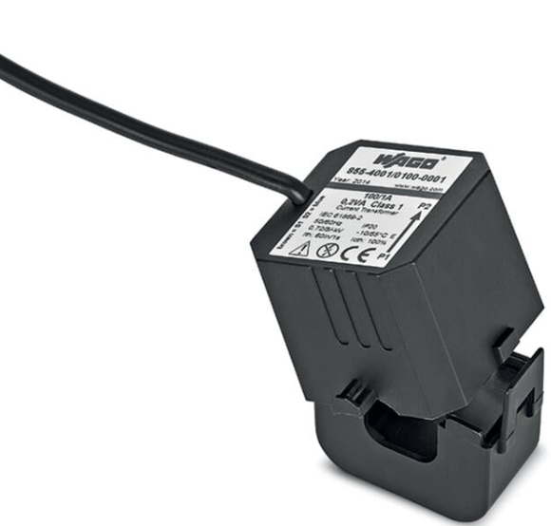
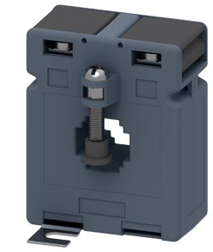


Energy Monitoring
Pioneering solutions for energy monitoring
Range of energy monitoring hardware (including)
1-phase and 3-phase meters with CE/MID Certification
DIN rail and panel mounting options
Optional, self-powered inductive meters
Modbus TCP/IP
Modbus RTU
Digital inputs/outputs
Measurement in-line or with CT’s
Current Transformers
Input Current: 50A up to 3000A
Output Current: 5A
Optional split CT’s for quick installation

Slide 13
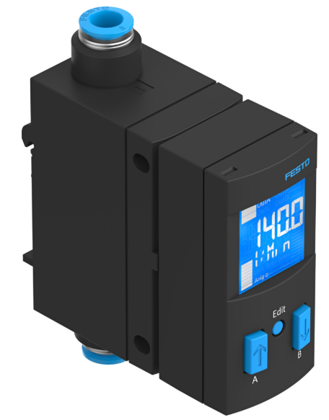

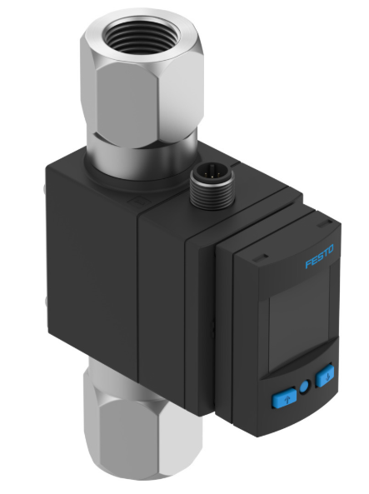
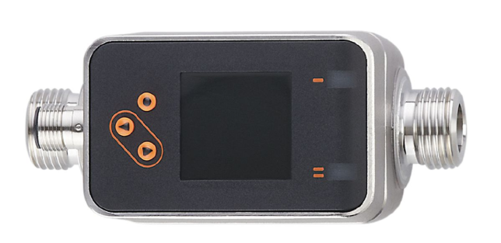
Utility Monitoring
Cost-effective solutions for liquid and gas monitoring
Solution to measure usage of compressed air, nitrogen, carbon dioxide, argon, etc.:
Compact design for point-of-use measurement
Up to 200L/min
4mm to 8mm tubing
-0.9 to 10 bar
Accuracy ±2% (o.m.v.)
Volumetric and totalised flow
Compatible with wireless technology
Solution to measure usage of liquids:
Compact design for point-of-use measurement
Configurable flow threshold with indication
Up to 100L/min
Up to ¾” NPT
0 to 12 bar
Up to 90ºC medium temperature
Accuracy ±2% (FS)
Volumetric and totalised flow
Compatible with wireless technology
Vortex flow meter to measure usage of liquids (including):
Deionised Water
Glycol solutions
Coolants

Slide 14
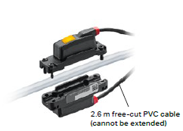
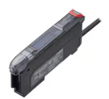
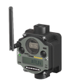

Clamp-on Solution
Non-intrusive measurement of compressed air
Specifications – Flow Sensor:
Pipe materials – pneumatic tubing (Polyurethane, Nylon, PFA)
Tube sizes – 6mm to 12mm (or ½”)
Accuracy – ±2%
Range – up to 1750L/min
Parameters - Volumetric and totalised flow
Rating – IP67
Supported fluids – Air, Nitrogen, Argon
Specifications – Amplifier Unit:
Digital Output - Instantaneous flow/integrated flow/alert output/pulse output
Analogue Output – 0/4-20mA
Connectivity – IO Link
Benefits:
Compatible with wireless technology
No moving parts
Maximum convenience and flexibility
Low installation cost compared to traditional flow metering technologies

Slide 15
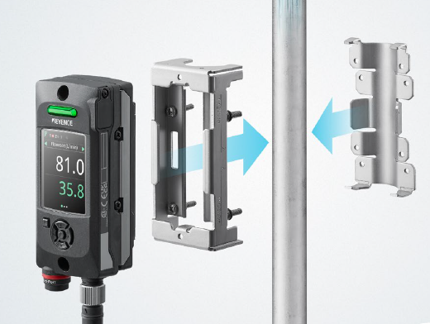
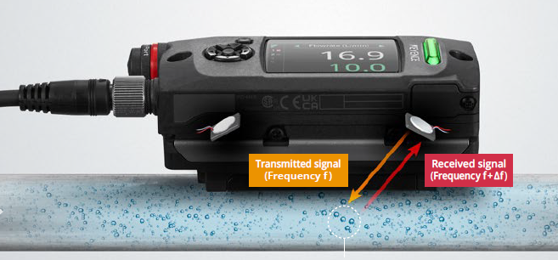
Clamp-on Solution
Non-intrusive measurement of virtually any liquid
Clamp-on solution to measure usage of:
Water
DI Water
Chemicals
Coolants
Oils
High Viscosity Liquids
Specifications:
Pipe materials – most metals and plastics, tubing and high-pressure hoses
Pipe sizes – 13mm to 44mm
Accuracy – ±3% (full pipe)
Range – up to 300L/min
Parameters - Velocity, Volumetric and totalised flow
Rating – IP67
Benefits:
Compatible with wireless technology
No moving parts
Maximum convenience and flexibility
Low installation cost compared to traditional flow metering technologies
Able to operate with liquids containing bubbles

Slide 16
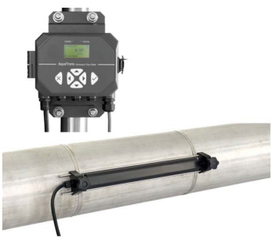
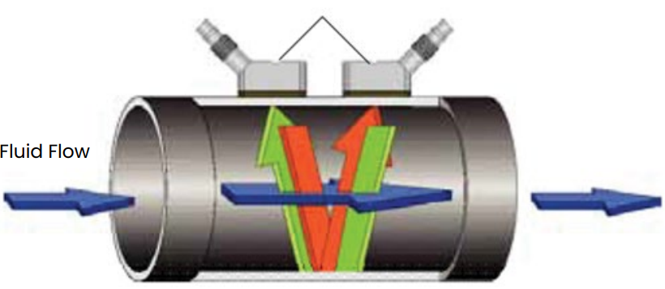

Water Monitoring
Economical non-intrusive water measurement
Clamp-on solution to measure usage of:
Potable Water
Wastewater
Sewage
Discharge water
Treated water
Cooling and heating water
Specifications:
Pipe materials – all metals and most plastics
Pipe sizes – 15mm to 7600mm
Accuracy – ±1% (full pipe)
Repeatability – ±0.2%
Range – up to 12m/s
Parameters - Velocity, Volumetric and totalised flow
Rating – IP67
Benefits:
Compatible with wireless technology
No moving parts
Maximum convenience and flexibility
Low installation cost compared to traditional flow metering technologies

Slide 17
Identification & Real Time Locating Systems
Know What’s Where – With Confidence
SmartFactory’s Identification & RTLS solutions enable precise traceability, location awareness, and automated verification of products, tools, and materials. These flexible identification solutions include RFID, barcode scanning, and vision systems to help eliminate manual entry errors.
Barcode Reading
Low-cost handheld or fixed-mount readers, with optional liquid lens technology, to trigger workflow steps.
Laser-etch 2D Data Matrix onto fixtures, for process verification.
Printing and verification of serialised labels.
RFID Tags and Readers
Accurately track assets, materials, and products to improve inventory management, streamline workflows, and enhanced quality control.
Vision Systems
Automate critical inspection and quality control processes to detect defects, verifying dimensions, and ensure accurate assembly.
Real-Time Locating System (RTLS)
SmartFactory’s RTLS provides ultra-accurate indoor positioning — like GPS, but for your factory. Track assets, tools, WIP, or personnel in real time with full two-way communication and integration into ERP systems and other site-wide applications.

Slide 18
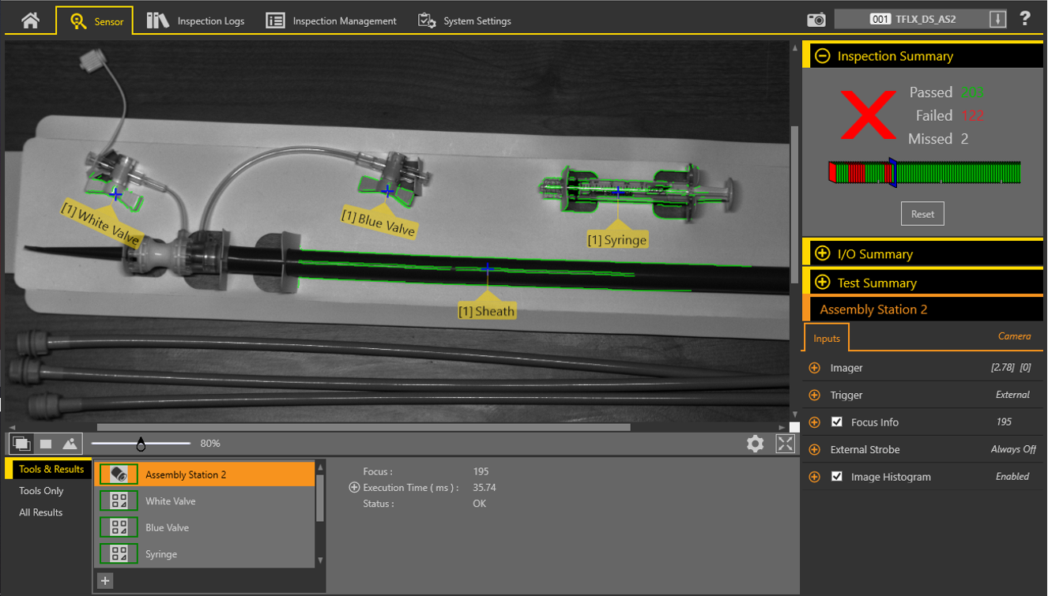
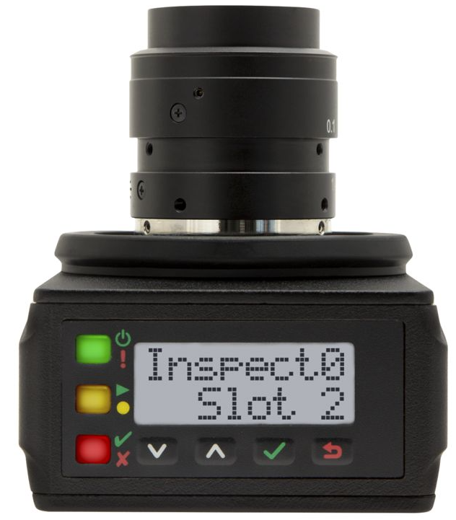
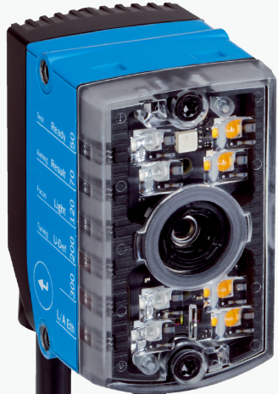

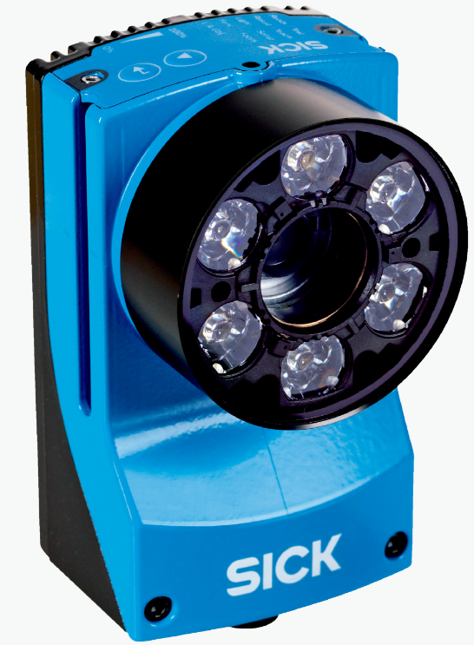




Identification and Vision Systems
Vision Systems, industrial barcode readers and RFID
Range of identification hardware (including)
Vision Systems
Industrial barcode readers, with optional liquid lens technology
RFID tags
RFID readers
Software
Full hardware and software integration with WAPS and customer databases
BARCODE
Liquid Lens Technology
RFID Transponders
RFID tags
RFID Labels

Slide 19





Real Time Locating System (RTLS)
Ultra-accurate, ultra-reliable, real-time location information
IEEE 802.15.4a/z
“Indoor GPS”
Link to RTLS Video
End-to-end solution (including)
Transponders
Wireless Gateways
Locating Software
Full integration with WAPS and customer databases
RTLS Transponder with e-paper and 2-way communication

Slide 20
Smart Connectivity Solutions
Connect Anything. Build Securely. Scale Without Limits.
From cybersecurity to signal conversion, SmartFactory’s connectivity solutions make it easy to bring real-time data from any sensor, machine, or line into your digital ecosystem — without major infrastructure changes.
Security and System Architecture
Design and deploy a secure, scalable, IIoT enabled industrial network that support edge computing, remote access, and real-time data collection — without compromise.
Snap Signal
Bring legacy analogue and discrete sensors into the digital world by converting their outputs and wirelessly transmitting them to a data Historian.
Smart Installation Solutions
Eliminate cabling delays with Power Bus — a modular 24V rail that lets you drop in wireless nodes without rewiring or cutting power.
Distributed IO-Link
Enable smart, decentralised communication and control of sensors and actuators
Wireless IO-Link
Reliable industrial communication, up to 20m. Easy extension or hybrid use with cabled IO-Link devices.

Slide 21






Networking & Security
Secure, ultra-reliable, industrial networks
End-to-end solution (including)
Cybersecurity consultancy
Industrial Network Design
Industrial Firewalls
Managed Routers and Switches
Industrial PoE Switches
Unmanaged industrial Switches
VPN and Secure Remote Access
NAT Devices
Specialised Antennas
High-gain antennas
Clean-design antennas
Directional and Omni-directional

Slide 22







SnapSignal Convertors
Convert any existing sensor to Modbus for integration with data collection system
Link to SnapSignal Video
Range of M12 Converters (including)
Digital to Modbus
Analogue to Modbus
Thermistor to Modbus
Current Transformer to Modbus
Range of M12 Splitters (including)
T-Splitter
2-way Splitter
8-port Splitter
Industrial Wireless
Serial Data Radios

Slide 23


Smart Installation Solutions
Innovative solutions engineered for quick and efficient deployment
Power Bus - allows you to quickly add wireless nodes anywhere along a 24V power line, minimizing cabling and maximizing flexibility
Distributed IO-Link - for rapid deployment of flexible RFID and Barcode verification solutions

Slide 24



Smart Installation Solutions
Accelerate your success with rapidly deployed innovations
Wireless IO-Link - enables reliable industrial communication between the IO-Link Wireless master and hubs. The highly scalable system ensures a reliable real-time data exchange in challenging environments.
Wireless IO-Link at a glance
Wireless communication up to 20 m
Up to 64 IO-Link devices per master
Interference-free frequency hopping
Data transmission with short delay time
IIOT integration (OPC-UA, MQTT, REST API)
Fieldbus integration
Compact IP67 design
Interlinking to reduce the power cabling
Wireless IO-Link Hubs - for rapid integration of multiple IO-Link devices
Benefits
Up to 75% less wiring
Simplified installation
Automated parameter setting
Enhanced diagnostics

Slide 25





Workflows
Pick-to-Light, Call-for-Parts and Call-for-Help
SmartFactory’s Pick-to-Light and Call-for-Parts solutions streamline manual operations by guiding operators visually, confirming actions, and speeding up kitting/Kanban operations.
Range of Pick-to-Light and Call-for-Parts hardware (including)
Touch Sensor and Optical Sensor with 3-digit LED Display
Optical Pick-to-Light sensor
Multicolour Touch with IO-Link
Wireless Gateway
Link to Pick-to-Light Video
Call-for-Help hardware (including)
Wireless buttons
Record and analyse technician response times
Record and analyse issue resolution times

Slide 26










Installation examples New and legacy equipment in medical device, pharmaceutical, food and general manufacturing
Wireless Connectivity
Injection Moulding
Thermoforming
Wired Connectivity
End-of-Line Packaging
Process Equipment
Data Logger
Device Test Skid
Manual Assembly

Slide 27







Company Overview
We understand manufacturing:
SmartFactory is led by a strong experienced team of engineers, with more than 25 years of experience in the manufacture of FMCG’s, Medical Devices and Electronics.
Modular & Scalable:
The modular solution includes:
OEE/Downtime Analysis ü Data Visualisation ü
Data Analytics/AI ü Digital Workflows ü
Condition Monitoring ü Real-Time Locating ü
Pick-to-Light ü Energy Monitoring ü
Digital Daily Management System ü
The SmartFactory team can provide an end-to-end solution including IIoT readiness assessment, business value and RoI appraisal, design, engineering consultancy, validation and industry-proven hardware.
Working with world-class clients:
In the following regions:
World-class partners:

Slide 28
SmartFactory IIoT Connectivity Solutions
Making Real-Time Data Acquisition Smart, Fast, Ultra-Reliable and Affordable
SmartFactory’s IIoT solutions have been designed to tackle one of the biggest challenges in manufacturing: collection of process, equipment, and environmental data from manual processes or legacy equipment. Our standard connectivity solutions integrate rugged industrial hardware, from the leaders in industrial automation.
1
Performance & Condition Monitoring
2
Sustainability & SEU Monitoring
3
Identification & Locating Solutions
4
Smart Connectivity Solutions
5
Workflows & Process Automation
Performance and Condition Monitoring
Wireless data capture for Downtime, Scrap, Rework, Vibration, Temperature, and Current, etc.
Sustainability and SEU Monitoring
Wired and Wireless data Capture for Energy and Utilities usage (Electricity, Gas, Water, Compressed Air, etc.).
Identification & Locating Solutions
Including Vision systems , barcode readers, RFID, and Real Time Locating Systems (RTLS).
Smart Connectivity Solutions
Industrial-grade cybersecurity and network infrastructure, plug and play integrations.
Workflows & Process Automation
Pick-to-Light, Call-for-Parts and Call-for-Help.

Slide 29


IIoT Toolkit (kit #4)
Connect Any Signal, From Any Sensor – Wirelessly
Modular nodes designed to support almost any I/O configuration: analogue, digital, thermistor, counters, or serial data — all over a secure wireless link.
Flex-power™ and battery powered options available
DX80 Input: 2 Discrete (PNP/NPN) 2 Analog 2 Thermistor
Output: 2 Discrete NMOS
DX80N2X6S-P2
Input: 4 Discrete (PNP/PNP) 2 Analog
Output: 4 Discrete PNP, 2 Analog 0-20mA
DX80N2X6S-P6
Input: 1-wire Serial Interface
PDX80N2X6S-P8
Input: Up to 12 Discrete PNP I/O
DX80N2X1S-P14
Input: 1 Configurable Discrete (PNP/NPN), 1 Analog Voltage (configurable to Current), 1 Thermistor, 1 Asynchronous Counter, 1 Switch Power Output

